Slide 1
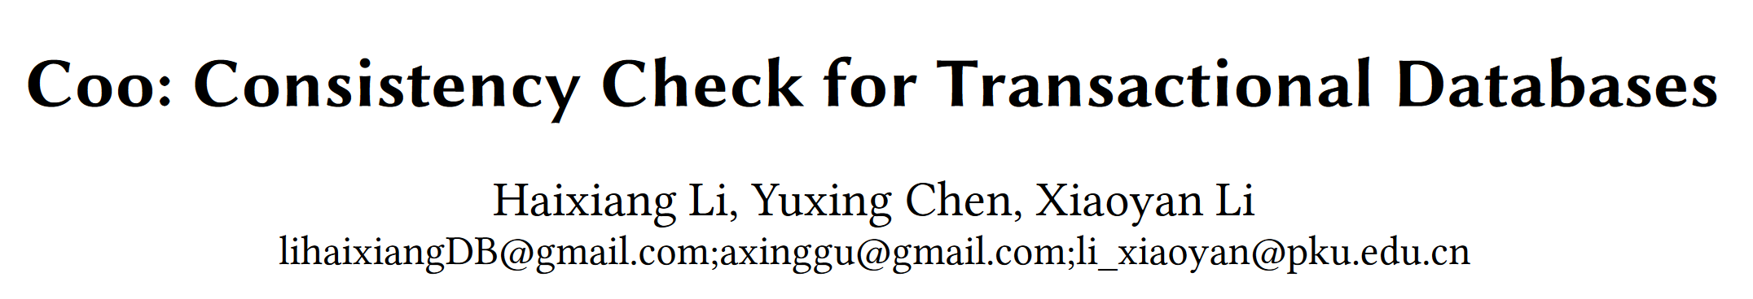


Slide 2
Outline
Background
Introduction & Coo framework
Consistency Model
Lemma & Proof
Evaluation
Conclussion

Slide 3
Background
Challenge of Consistency
It is often controversial and lacks standards.
It has a high knowledge bar to understanding/modifying test cases and analyzing and debugging anomalies.
It also has a high verification cost, it is proved to be a NP-complete problem to verify a serializable commit order of all transactions.
Other challenges
The formal definition of data anomalies.
Relate inconsistency to all data anomalies.

Slide 4
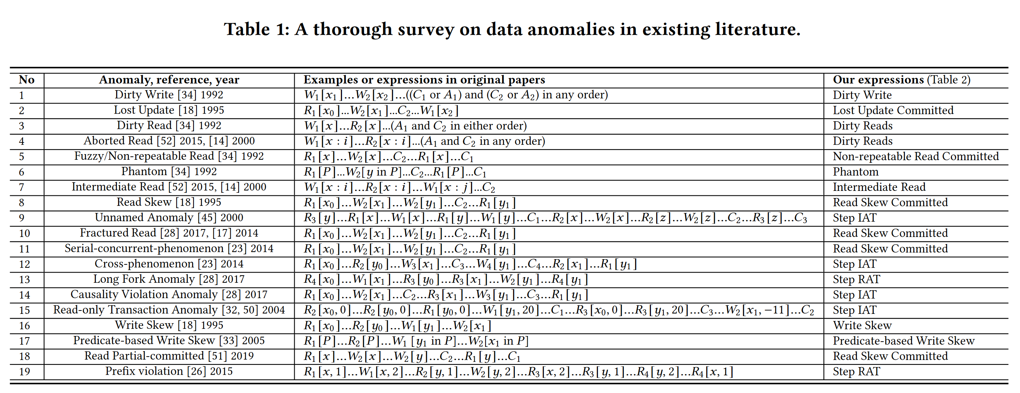
Background
The standard anomalies are single object and avoided by lock-based protocols,
yet more complex data anomalies, which are occasionally reported case by case as shown in Table 1, are hardly fit into defined levels.

Slide 5
Outline
Background
Introduction & Coo framework
Consistency Model
Lemma & Proof
Evaluation
Conclussion

Slide 6
Contribution
Proposed the concept of partial order pair graph, which can represent all data anomalies.
Redefined consistency and data anomalies by proposing lemmas and evidence.
Verified the consistency of various databases through the COO framework.
Reported 20+ new types of data anomalies.

Slide 7
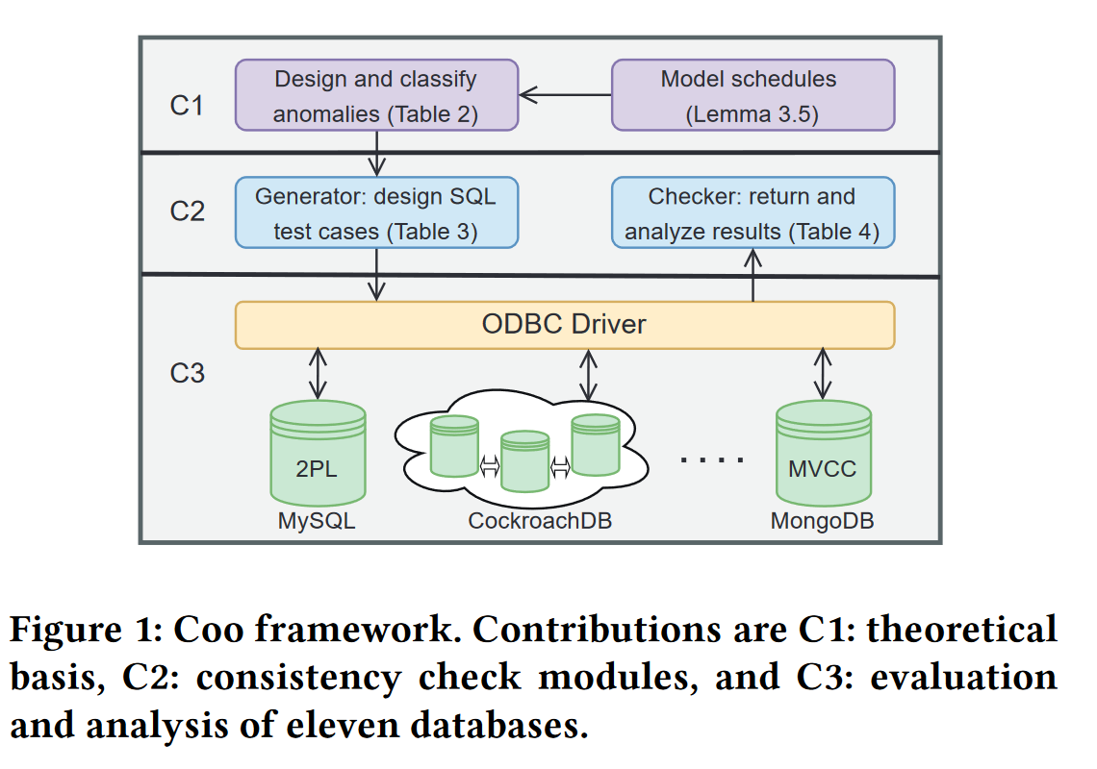
Introduction & Coo framework
Generator module provides SQL-like queries and schedules based on our definition of data anomalies,
Checker module recognizes the consistent and inconsistent behaviors of the executed schedules.

Slide 8
Outline
Background
Introduction & Coo framework
Consistency Model
Lemma & Proof
Evaluation
Conclussion

Slide 9
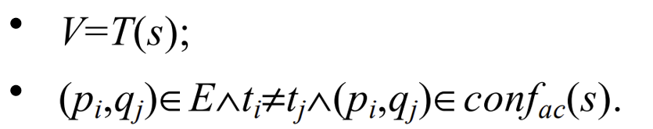
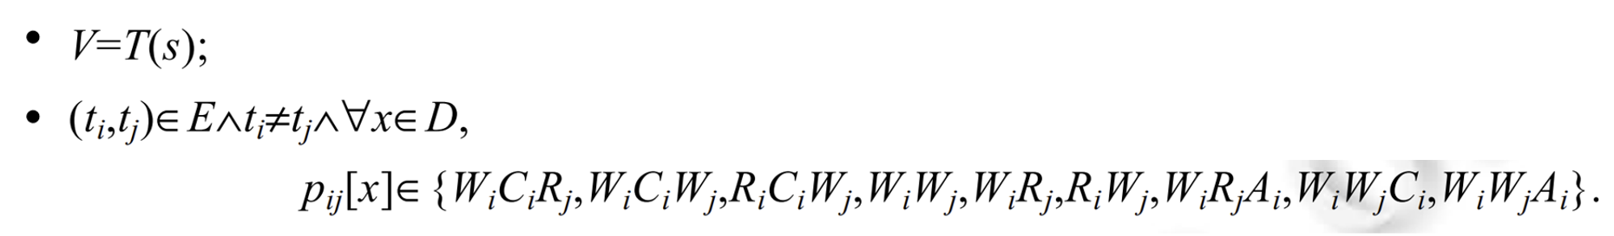
Consistency Model
Definition 3.1. Partial Order Pair (POP)
• Multiple transactions operate on the same object;
• At least one operation affects the object version (eg. a write or a rollback of write).
Definition 3.2. Conflict with status Graph(CCAG graph)
Definition 3.3. Partial Order Pair Graph (POP graph)

Slide 10
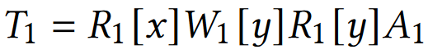
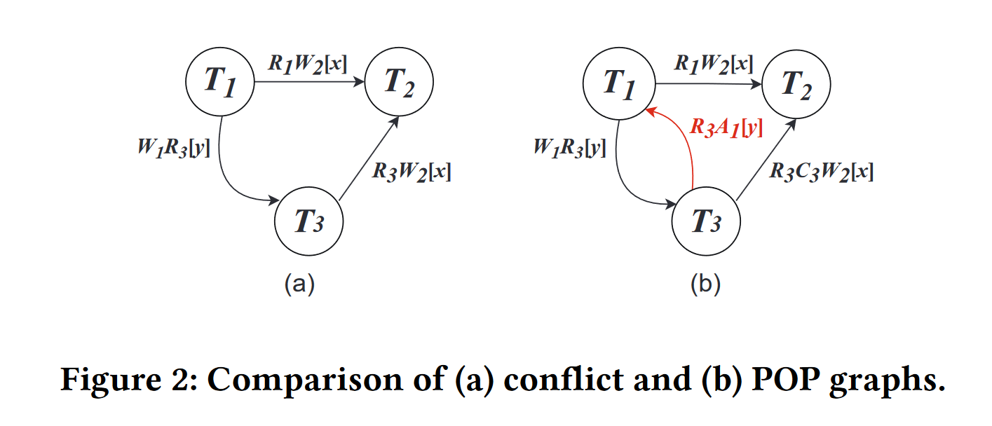
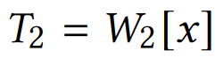
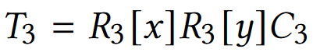
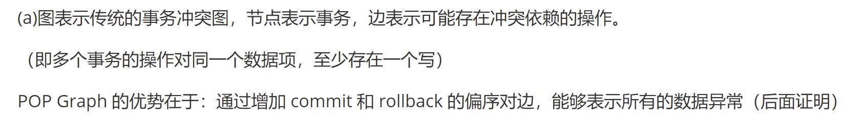
Consistency Model
Example 3.1
schedule:
(still active)

Slide 11
Outline
Background
Introduction & Coo framework
Consistency Model
Lemma & Proof
Evaluation
Conclussion

Slide 12
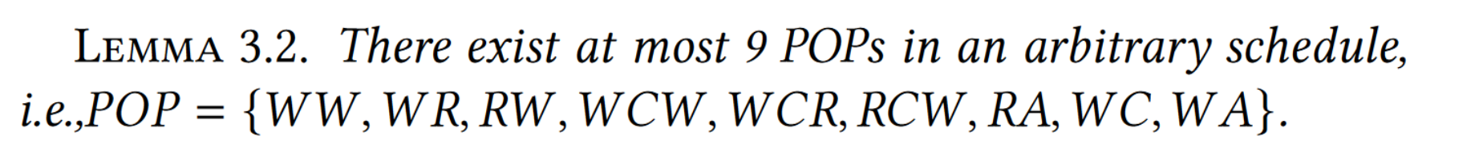
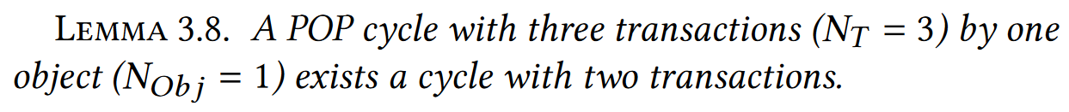
Lemma & Proof

Slide 13
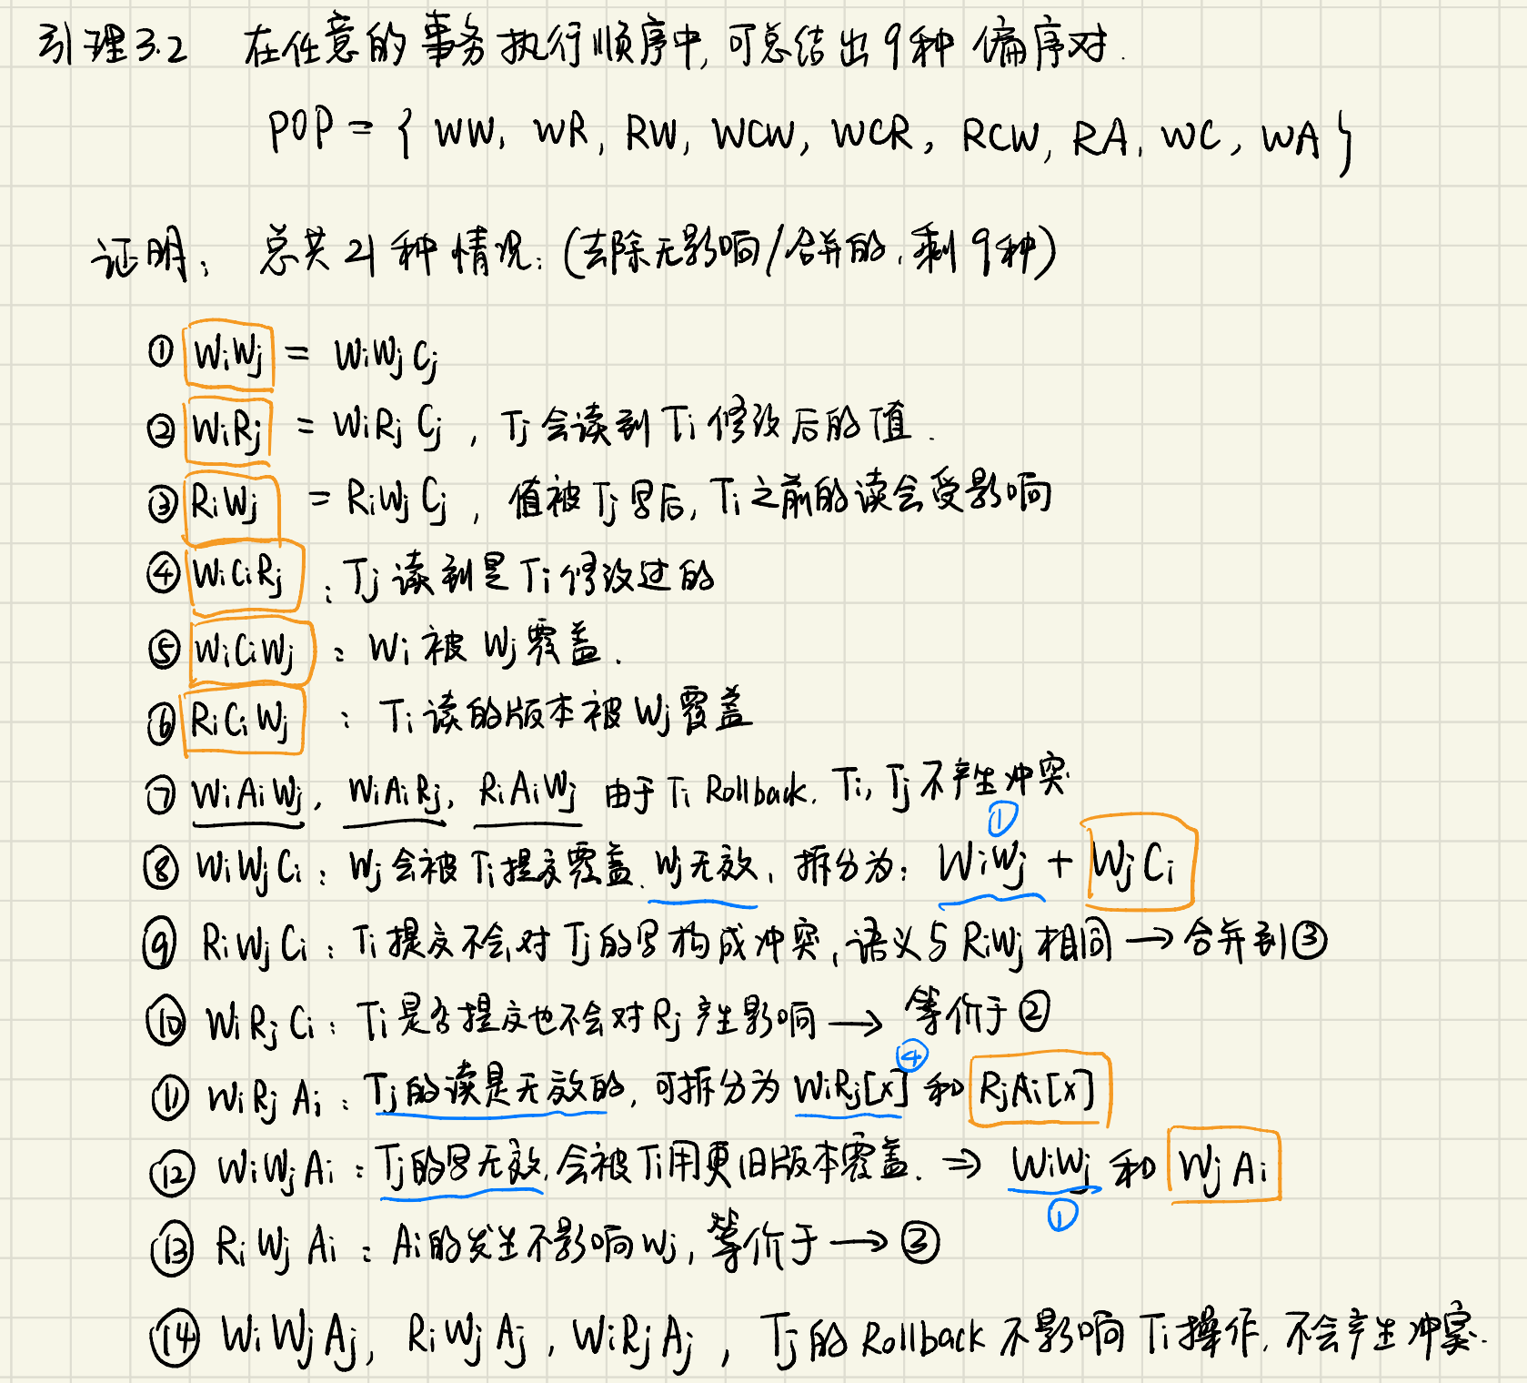
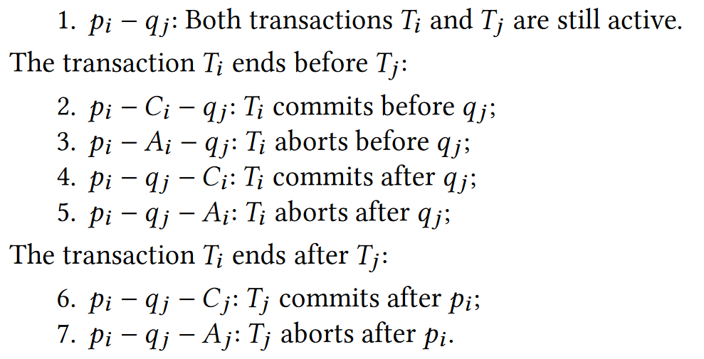
Lemma & Proof

Slide 14
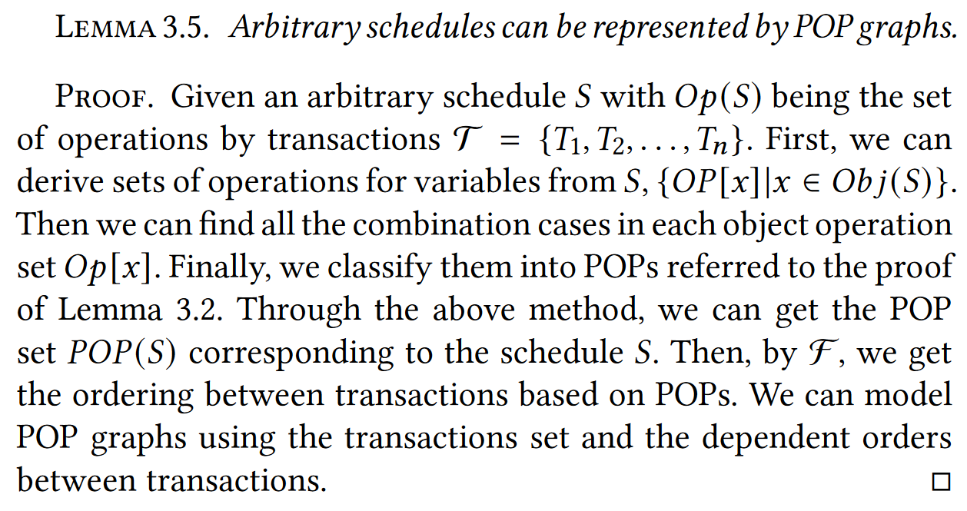
Lemma & Proof
简而言之，在调度中可以找到对同一数据对象的所有操作集合，而任意操作排序均可以通过前面证明的九种偏序对构成，因此任意调度均可建POP图

Slide 15
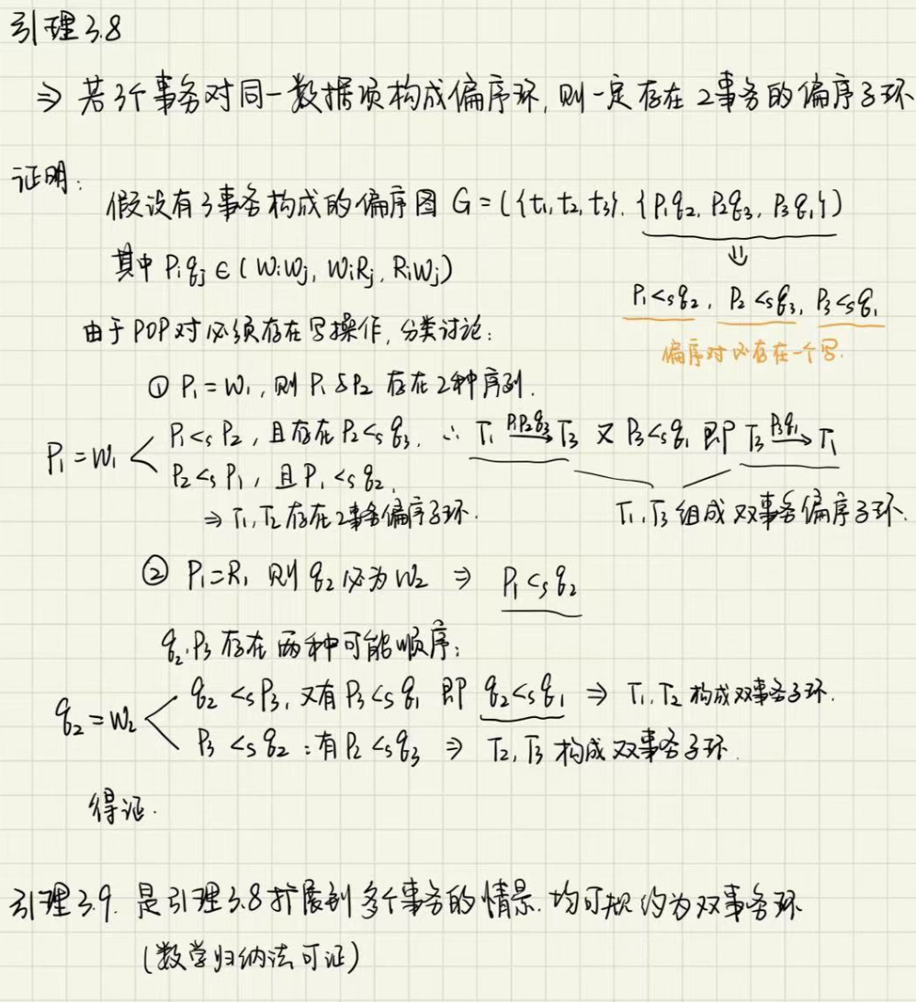
Lemma & Proof

Slide 16
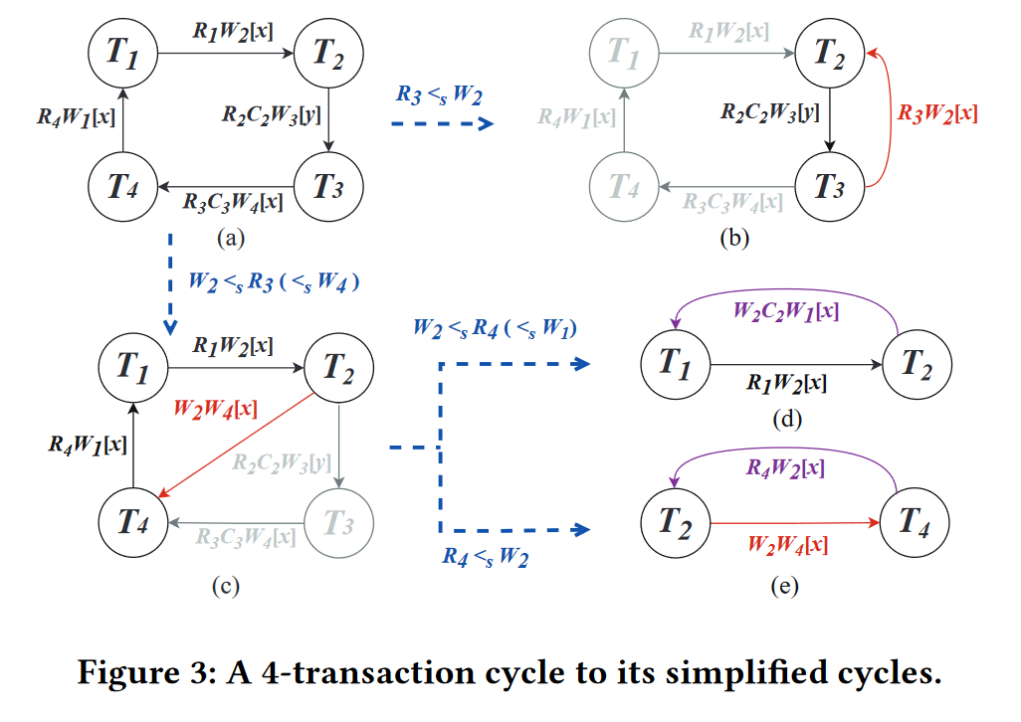
Lemma & Proof

Slide 17
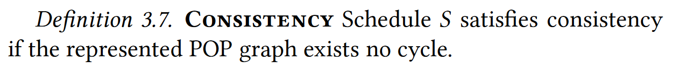
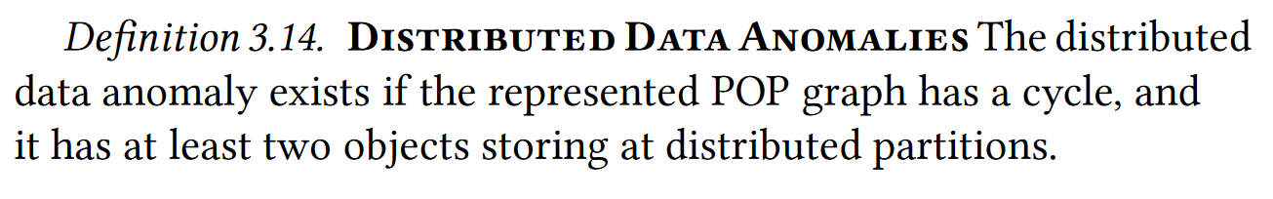
Formal definition of data anomalies and consistency

Slide 18
Types of Anomalies
Types of Anomalies. (two classifications)
The first is based on primitive conflict dependencies, i.e., WR, WW, and RW:
(1) Read Anomaly Type (RAT), if the cycle has at least a WR POP;
(2) Write Anomaly Type (WAT), if the cycle does not have a WR POP, but have at least a WW POP;
(3) Intersect Anomaly Type (IAT), if the cycle does not have WR and WW POPs.
The second is based on number of transactions (NT) and objects (Nobj):
(1) Single Data Anomaly (SDA), if NT = 2, Nobj = 1;
(2) Double Data Anomaly (DDA), if NT = 2, Nobj = 2;
(3) Multi transaction Data Anomaly (MDA).

Slide 19
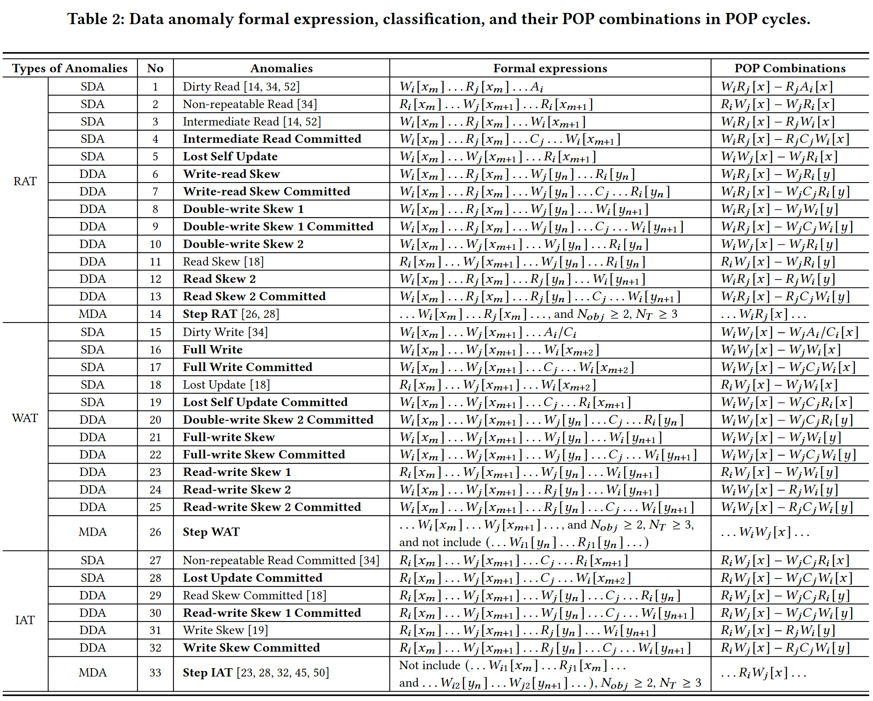
Types of Anomalies
Table 2 shows all data anomalies types and their classification.
The anomaly names with BOLD font are 20+ new types of anomalies that have never been reported.

Slide 20
Outline
Background
Introduction & Coo framework
Consistency Model
Lemma & Proof
Evaluation
Conclussion

Slide 21
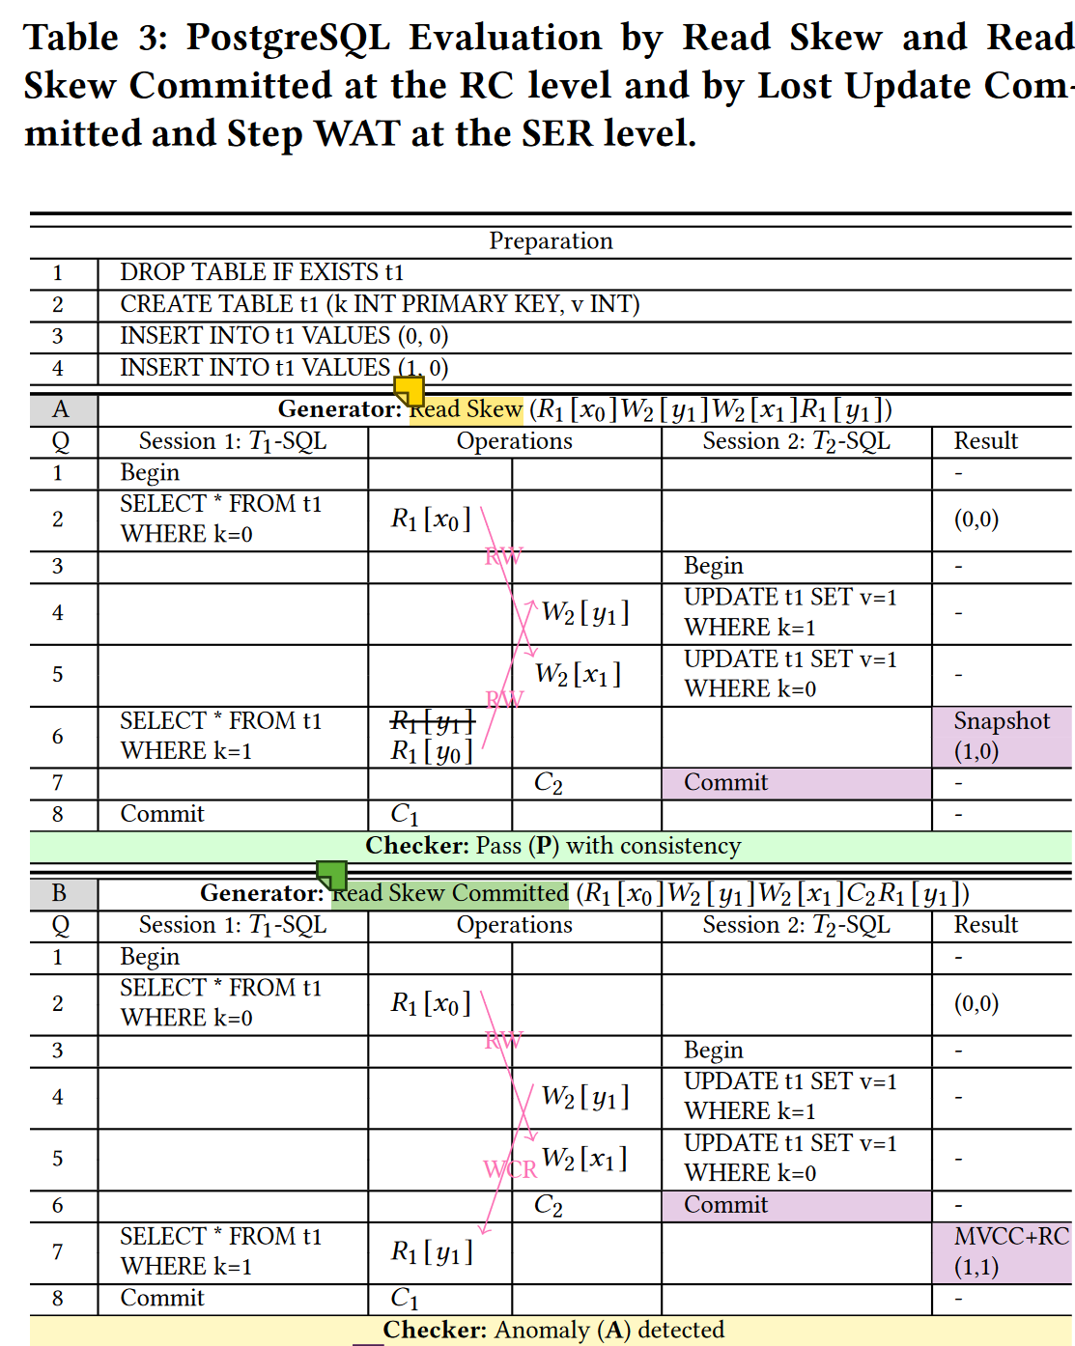
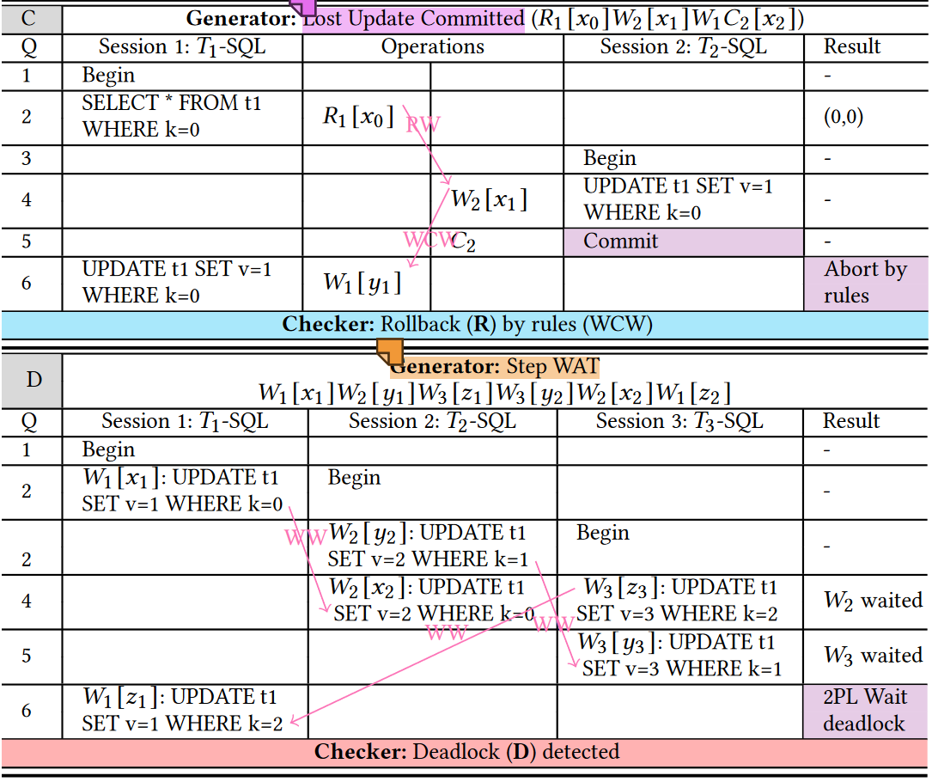
Evaluation
A: Pass, it doesn’t exist any anomalies.
B: Exist data anomaly, but the database allow them in its isolation level.
C: Anomaly happened, but it can be solved by rollback in some rules.
D: Deadlock detected, but the database can rollback trxs and retry them.

Slide 22
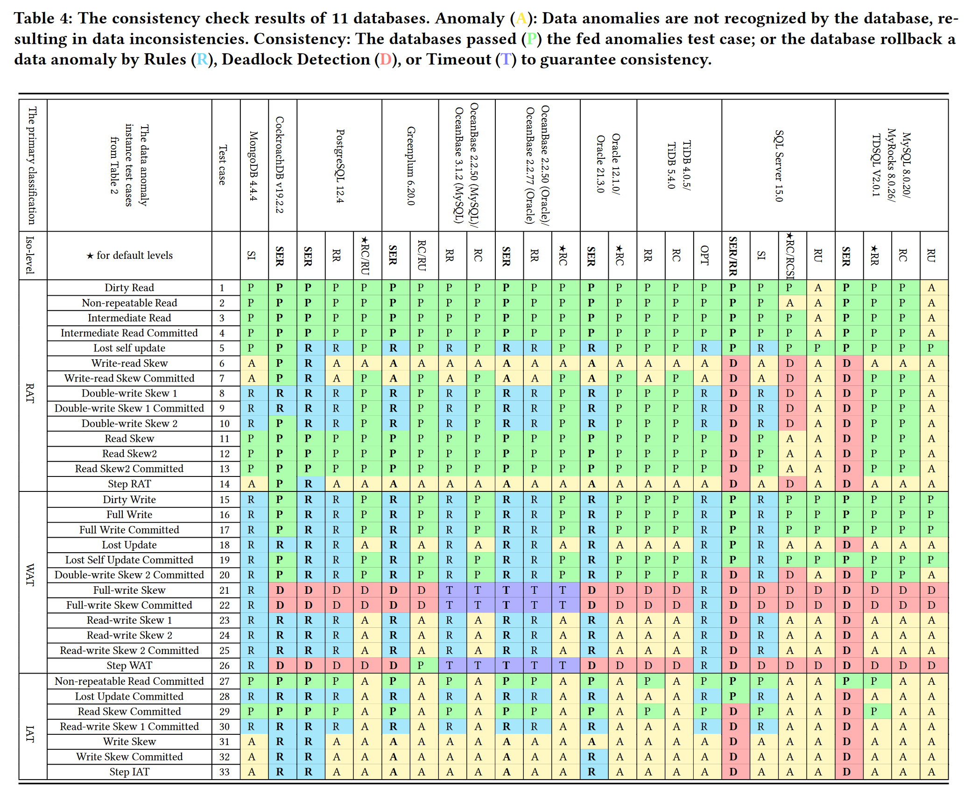
Evaluation

Slide 23
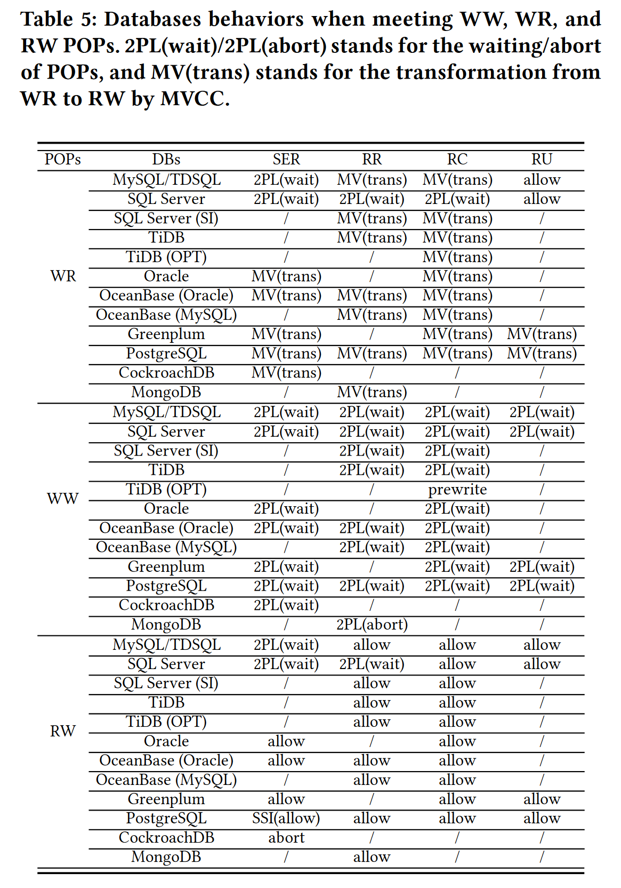
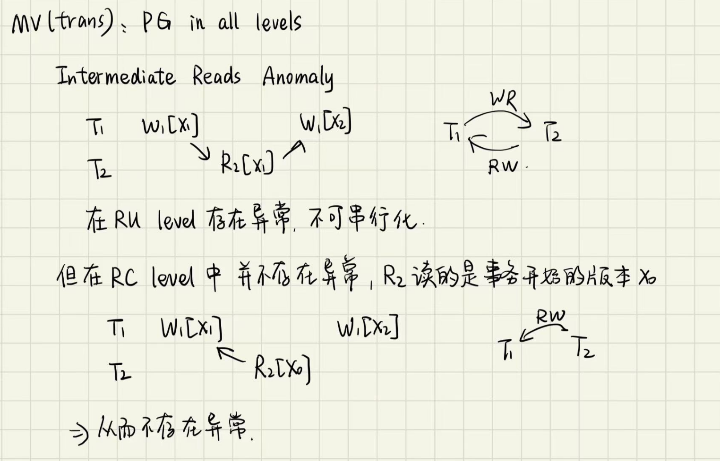
Evaluation
Lesson learned:
(1) Databases aim at consistency by avoiding all or partial POP cycles, and have different behaviors on different POPs. (2) Different CC protocols are differently implemented between databases and between isolation levels.
(3) Developers still lack complete understanding between SER level and eliminating four standard anomalies, and between coarse isolation levels.

Slide 24
Outline
Background
Introduction & Coo framework
Consistency Model
Lemma & Proof
Evaluation
Conclussion

Slide 25
Conclussion
This paper proposed Coo, which contributed to check the consistency of databases, filling the gap in contrast to real-time or post verify solutions.
Introduced an extended conflict graph model called Partial Order Pair (POP) Graph, which also considers state-expressed operations.
Redefined data anomalies and consistency with POP cycles.
Classified data anomalies and reported 20+ new types of them.

